Slide 1
Gen AI-Based Data Profiling for Regulatory Reporting
ESSWarriors | Hackathon-2025

Slide 2
Challenge Overview
Regulatory reporting in banking requires vast data validation.
Manual data profiling is time-consuming and error-prone.
Objective: Automate data profiling using Generative AI and Unsupervised ML.
Goal: Ensure compliance by generating profiling rules, risk scores, and remediation actions.

Slide 3
Problem Statement
Develop an AI-powered data profiling solution to:
Extract & interpret regulatory reporting instructions.
Generate profiling rules using LLMs/ML.
Validate reported data using executable Python code.
Identify anomalies.
Suggest remediation with automated explanations.

Slide 4
Understanding Data Profiling
Definition: Data profiling is the process of examining, analyzing, and summarizing data to ensure its quality, consistency, and compliance.
Key Aspects:
Completeness: Ensuring all necessary data is present.
Accuracy: Data correctly represents real-world scenarios.
Consistency: Data conforms to defined formats and rules.
Uniqueness: Identifying duplicate records.
Integrity: Validating relationships between different datasets.
Importance in Regulatory Reporting: Helps in identifying inconsistencies and ensuring compliance with financial regulations.

Slide 5
Solution Approach
Data Extraction: Interpret reporting instructions using LLMs (GPT, LLaMA, Falcon).
Profiling Rule Generation: ML-based validation logic & relationships.
Validation Engine: Python code execution for data verification.
Remediation Module: Automated suggestions for flagged transactions.
Interactive Compliance Assistant(Chat Bot): User-friendly UI for auditors.

Slide 6
System Architecture
Input: Regulatory Instructions + Transaction Data (CSV).
Processing: LLMs for rule extraction, ML for anomaly detection.
Validation Engine: Code generation for validation checks.
Output: Profiling rules, anomaly detection results, remediation suggestions.

Slide 7
Implementation Details
Tech Stack:
LLMs: OpenAI GPT, Hugging Face Models
ML: Scikit-learn, PyCaret, AutoML
Data Processing: Pandas, NumPy
Code Generation: LangChain
UI/Interactivity: Streamlit, Gradio
Pipeline Workflow: Data Ingestion → Rule Extraction → Validation → Remediation

Slide 8
Workflow
User Input (CSV File):
The server accepts a dataset in CSV format for processing.
Task 1: Anomaly Detection & Outlier Removal
Isolation Forest ML Algo is used to detect anomalies in the dataset.
It generates an outlier removal visualization, cleaned dataset, removed outlier dataset and outlier report.
Task 2: LLM-Powered Validation
The extracted data is sent to Program which has predefined validation functions and LLM.
Similar data fields are grouped and validation functions are created for them.
LLM searches context for data fields in regulatory documents stored in a Vector Store.
Validator Module applies predefined validation functions & extracted context to check rule compliance.
Validation Report Generation
Generates a report listing invalid rows along with relevant contextual explanations.

Slide 9
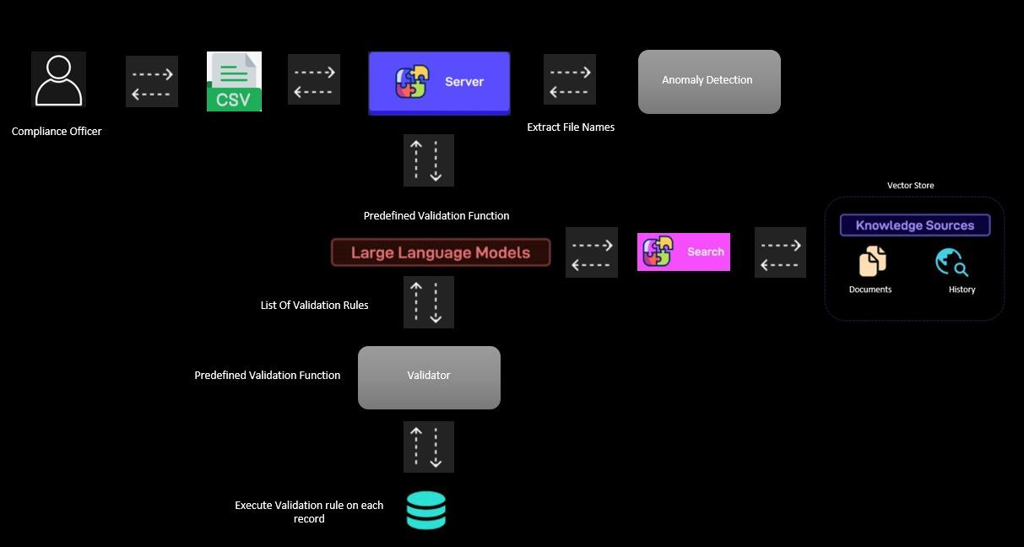
Workflow Diagram

Slide 10
Interactive Compliance Assistant(Chat Bot)
The chatbot allows users (auditors/compliance officers) to query regulatory reporting requirements.
Workflow
User Query Input: The chatbot takes user queries related to regulatory compliance.
Server Processing: The query is sent to the backend server.
Vector Store Search: The server searches historical documents and regulatory data stored in a Vector Database.
Context Retrieval: The vector store returns relevant historical context.
Contextualized Query to LLM: The query, enriched with context, is sent to the LLM for response generation.
LLM Response: The AI generates a response based on both user input and retrieved context.
Output Display: The chatbot presents the answer to the user.

Slide 11
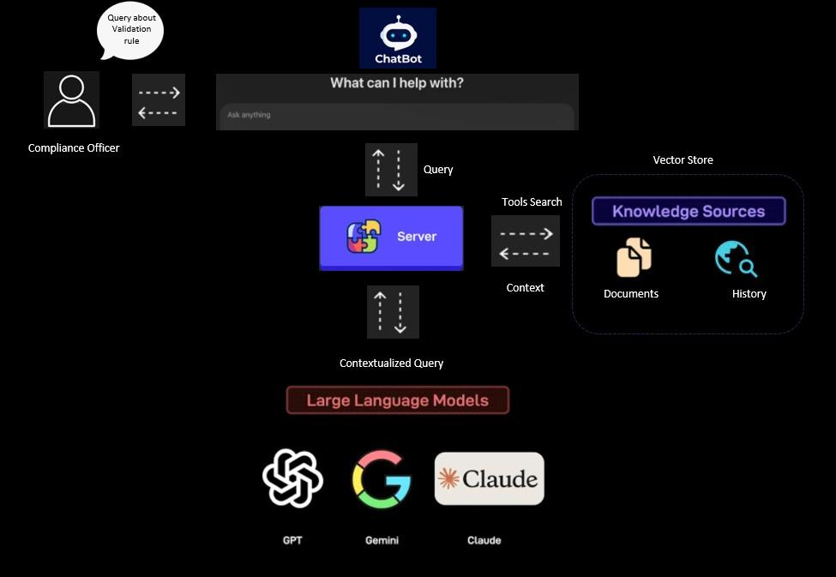
ChatBot Diagram:

Slide 12
Challenges Faced
Data Quality Issues: Missing/incomplete regulatory guidelines.
LLM Interpretability: Ensuring accuracy in rule extraction.
Scalability: Handling large datasets efficiently.
Regulatory Complexity: Adapting to evolving rules dynamically.

Slide 13
Future Enhancements
Integrate Reinforcement Learning: Improve rule accuracy with feedback loops.
Enhance Explainability: Generate more intuitive remediation reports.
Expand Multi-Language Support: Process regulatory instructions in different languages.
Deploy as a Web App: Provide an interactive platform for auditors.

Slide 14
Conclusion
Automating Data Profiling with AI improves efficiency, accuracy, and compliance.
Our solution extracts rules, validates data, detects anomalies, and suggests remediations.
Scalable, Explainable, and Efficient: Ensures regulatory compliance dynamically.
Next Steps: Further refinement, real-world testing, and UI enhancements.

